Slide 1
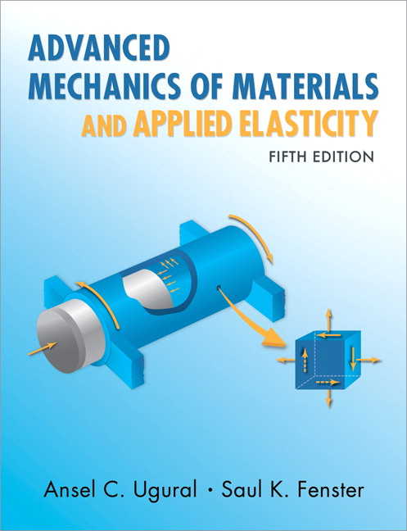
Advanced Mechanics
(Lecture 20)
ANNOUNCE / BUSINESS
HW 09 (due Today, 3/25)
HW 10 (due Thursday, 3/27)
Exam 03: Thursday, 04/03
PREVIOUS
Torsion
TODAY
Axi-symmetric loading
Thin-walled cylinders
Thick-walled cylinders
Rotating disk

Slide 2
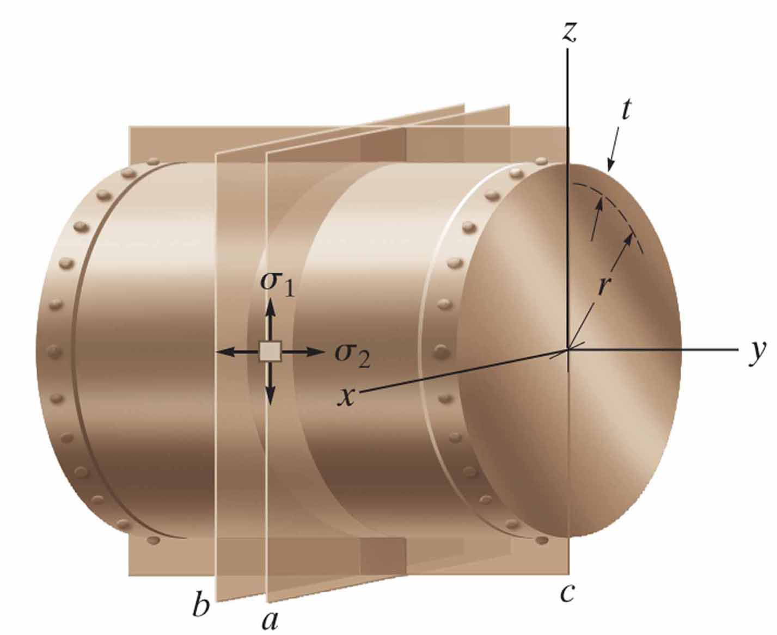
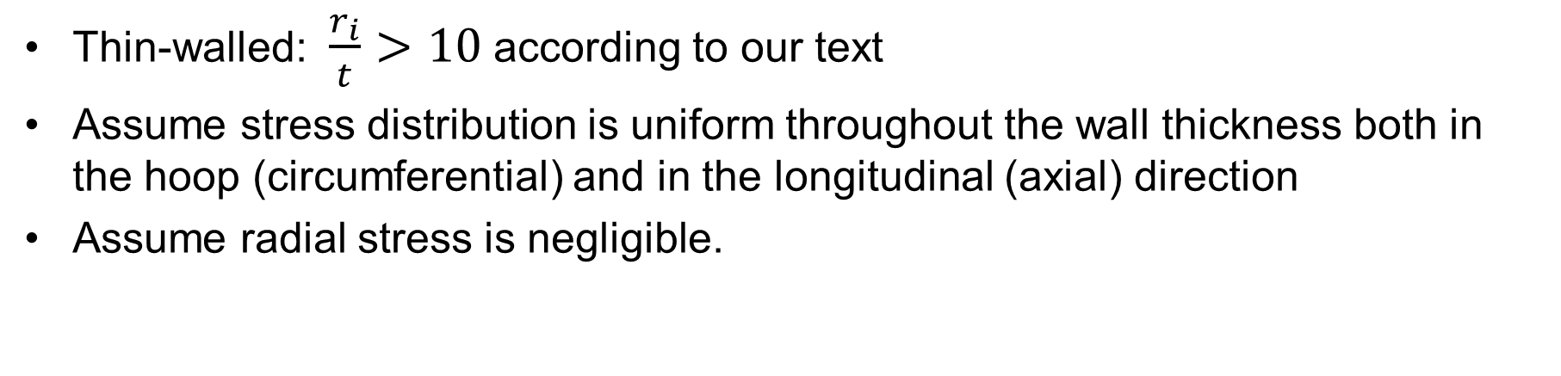
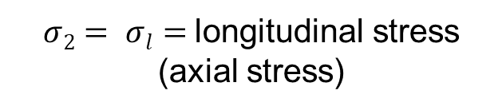
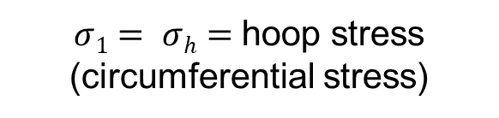
Thin-Walled Cylinders
Thin-walled: $\frac{r_{i}}{t}>10$ according to our text
Assume stress distribution is uniform throughout the wall thickness both in the hoop (circumferential) and in the longitudinal (axial) direction
Assume radial stress is negligible.
$σ1= σh=$hoop stress (circumferential stress)
$σ2= σl=$longitudinal stress (axial stress)

Slide 3
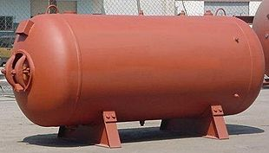
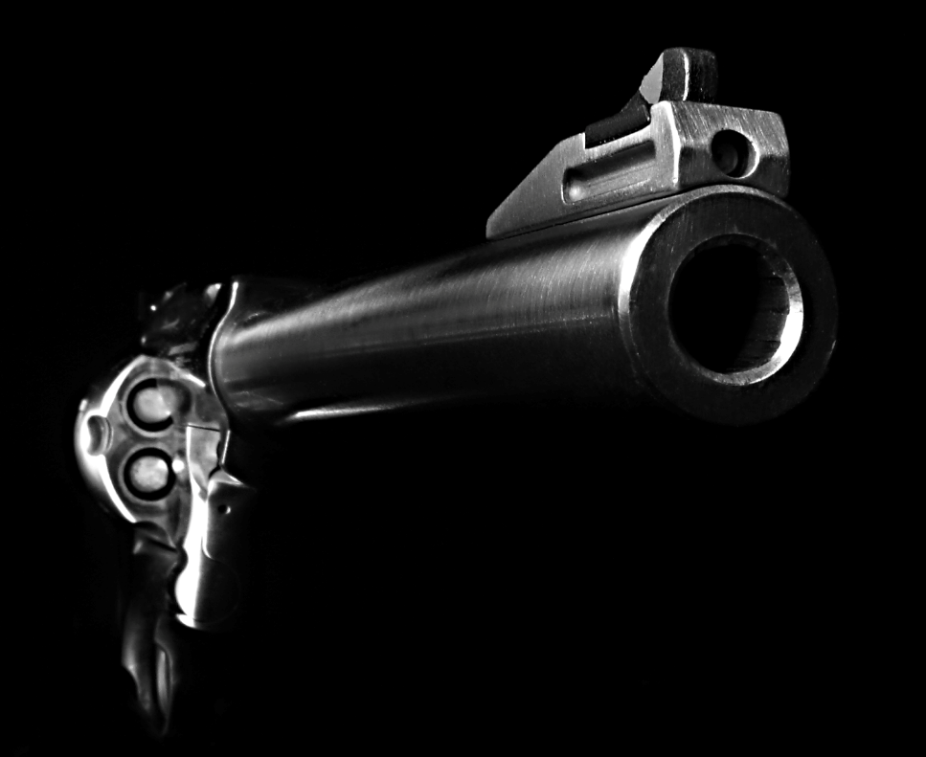
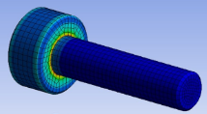
Thick-Walled Pressure Vessels

Slide 4
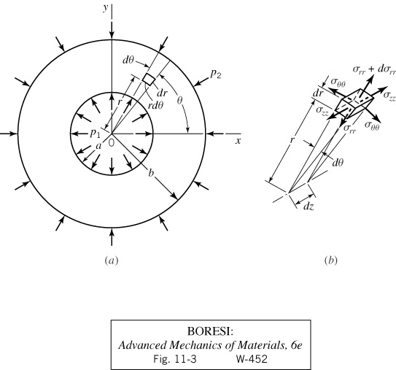
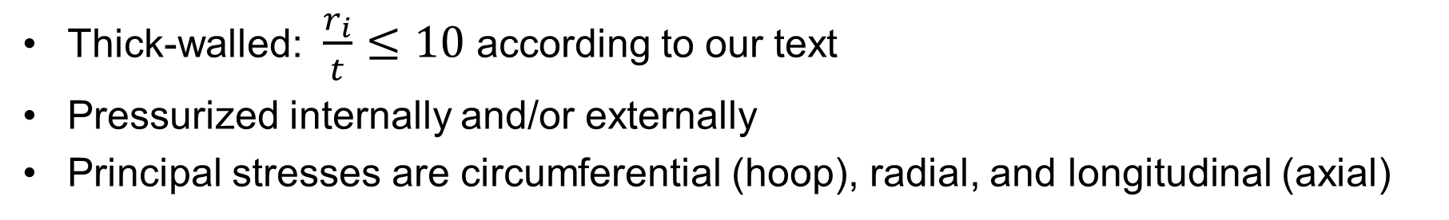
Thick-Walled Cylinders
Thick-walled: $\frac{r_{i}}{t}≤10$ according to our text
Pressurized internally and/or externally
Principal stresses are circumferential (hoop), radial, and longitudinal (axial)

Slide 5
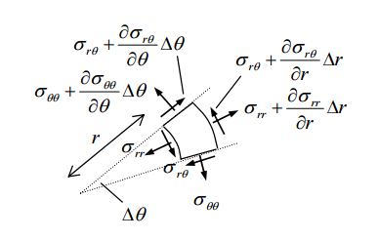
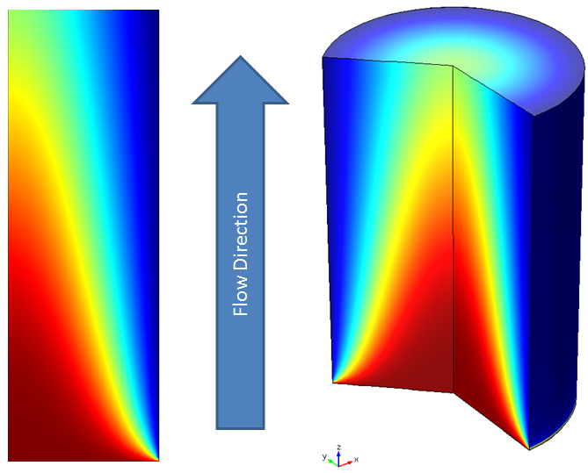



Stress in Axisymmetric Loading
Equations of Equilibrium (cylindrical coords; no body forces)
$$\frac{∂σ_{r}}{∂r}+\frac{1}{r}\frac{∂τ_{rθ}}{∂θ}+\frac{∂τ_{rz}}{∂z}+\frac{σ_{r}−σ_{θ}}{r}=0$$
$$\frac{∂τ_{θr}}{∂r}+\frac{1}{r}\frac{∂τ_{θ}}{∂θ}+\frac{∂τ_{θz}}{∂z}+2\frac{τ_{θr}}{r}=0$$
$$\frac{∂τ_{zr}}{∂r}+\frac{1}{r}\frac{∂τ_{zθ}}{∂θ}+\frac{∂σ_{z}}{∂z}+\frac{τ_{zr}}{r}=0$$
Assumptions:
(1) Axisymmetric

Slide 6
Stress in Axisymmetric Loading
Equations of Equilibrium (cylindrical coords; no body forces)
0
$$\frac{∂σ_{r}}{∂r}+\frac{1}{r}\frac{∂τ_{rθ}}{∂θ}+\frac{∂τ_{rz}}{∂z}+\frac{σ_{r}−σ_{θ}}{r}=0$$
0
0
0
$$\frac{∂τ_{θr}}{∂r}+\frac{1}{r}\frac{∂τ_{θ}}{∂θ}+\frac{∂τ_{θz}}{∂z}+2\frac{τ_{θr}}{r}=0$$
0
$$\frac{∂τ_{zr}}{∂r}+\frac{1}{r}\frac{∂τ_{zθ}}{∂θ}+\frac{∂σ_{z}}{∂z}+\frac{τ_{zr}}{r}=0$$
Assumptions:
(1) Axisymmetric

Slide 7
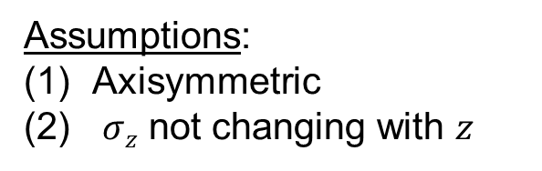
Stress in Axisymmetric Loading
Equations of Equilibrium (polar coords; no body forces)
0
$$\frac{∂σ_{r}}{∂r}+\frac{1}{r}\frac{∂τ_{rθ}}{∂θ}+\frac{∂τ_{rz}}{∂z}+\frac{σ_{r}−σ_{θ}}{r}=0$$
0
0
$$\frac{∂τ_{θr}}{∂r}+\frac{1}{r}\frac{∂τ_{θ}}{∂θ}+\frac{∂τ_{θz}}{∂z}+2\frac{τ_{θr}}{r}=0$$
0
0
$$\frac{∂τ_{zr}}{∂r}+\frac{1}{r}\frac{∂τ_{zθ}}{∂θ}+\frac{∂σ_{z}}{∂z}+\frac{τ_{zr}}{r}=0$$
Assumptions:
Axisymmetric
$σz$ not changing with $z$

Slide 8
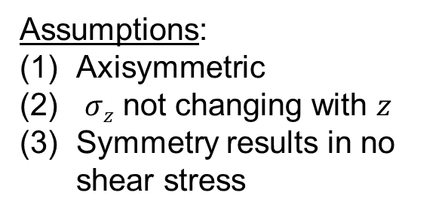
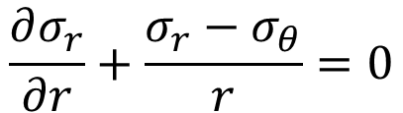
Stress in Axisymmetric Loading
Equations of Equilibrium (polar coords; no body forces)
0
0
$$\frac{∂σ_{r}}{∂r}+\frac{1}{r}\frac{∂τ_{rθ}}{∂θ}+\frac{∂τ_{rz}}{∂z}+\frac{σ_{r}−σ_{θ}}{r}=0$$
0
0
0
0
$$\frac{∂τ_{θr}}{∂r}+\frac{1}{r}\frac{∂τ_{θ}}{∂θ}+\frac{∂τ_{θz}}{∂z}+2\frac{τ_{θr}}{r}=0$$
0
0
0
0
$$\frac{∂τ_{zr}}{∂r}+\frac{1}{r}\frac{∂τ_{zθ}}{∂θ}+\frac{∂σ_{z}}{∂z}+\frac{τ_{zr}}{r}=0$$
$$\frac{∂σ_{r}}{∂r}+\frac{σ_{r}−σ_{θ}}{r}=0$$
Assumptions:
Axisymmetric
$σz$ not changing with $z$
Symmetry results in no shear stress

Slide 9
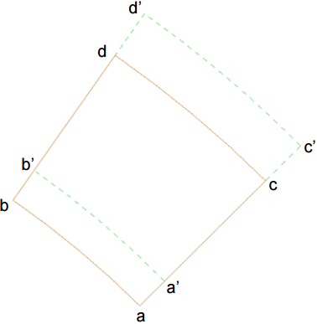



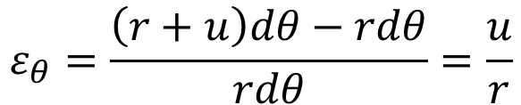
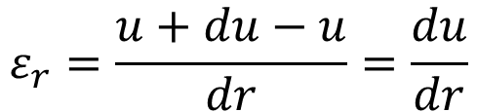

Strain in Axisymmetric Loading
$$r$$
Radial strain
Circumferential strain
$$ε_{r}=\frac{u+du−u}{dr}=\frac{du}{dr}$$
$$s_{ab}=rdθ$$
u+ du
$$s_{a^{′}b′}=(r+u)dθ$$
$$p$$
$$ε_{θ}=\frac{\left(r+u\right)dθ−rdθ}{rdθ}=\frac{u}{r}$$
u

Slide 10
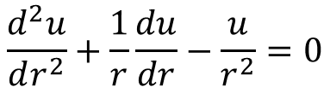


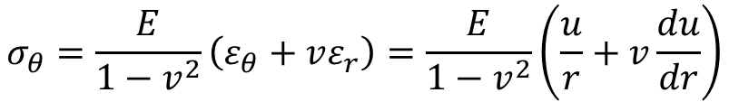
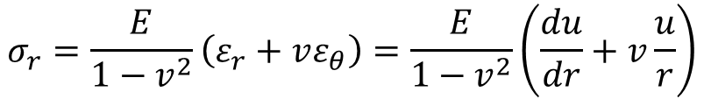
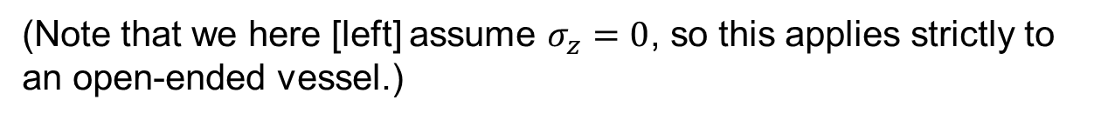


Axisymmetric Loading
Assuming linear isotropy
$$ε_{r}=\frac{1}{E}\left(σ_{r}−vσ_{θ}\right)=\frac{du}{dr}$$
$$σ_{r}=\frac{E}{1−v^{2}}\left(ε_{r}+vε_{θ}\right)=\frac{E}{1−v^{2}}\left(\frac{du}{dr}+v\frac{u}{r}\right)$$
$$ε_{θ}=\frac{1}{E}\left(σ_{θ}−vσ_{r}\right)=\frac{u}{r}$$
$$σ_{θ}=\frac{E}{1−v^{2}}\left(ε_{θ}+vε_{r}\right)=\frac{E}{1−v^{2}}\left(\frac{u}{r}+v\frac{du}{dr}\right)$$
(Note that we here [left] assume $σ_{z}=0$, so this applies strictly to an open-ended vessel.)
Now substitute into equilibrium equation:
$$r\frac{∂σ_{r}}{∂r}+σ_{r}−σ_{θ}=0$$
$$\frac{d^{2}u}{dr^{2}}+\frac{1}{r}\frac{du}{dr}−\frac{u}{r^{2}}=0$$
$$u=c_{1}r+\frac{c_{2}}{r}$$

Slide 11
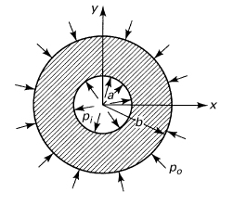





Thick-Walled Cylinders
Now write stresses in terms of solution constants,
(Note that $σ_{r}+σ_{θ}$ does not change with $r$; can thus conclude that $ε_{z}$ does not change with $r$, via Hooke’s Law.)
And apply boundary conditions to determine constants,

Slide 12
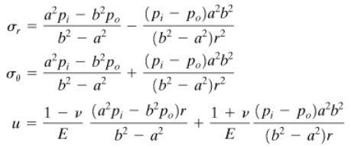



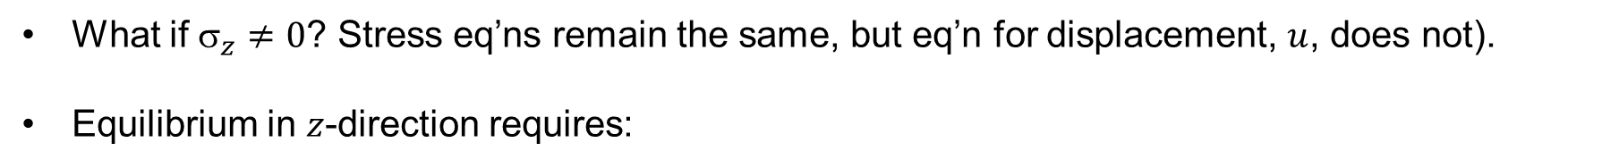


Stress in Thick-Walled Cylinders
What if ${\text{s}}_{z}≠0$? Stress eq’ns remain the same, but eq’n for displacement, $u$, does not).
Equilibrium in $z$-direction requires:
$$σ_{z}$$
$$p_{i}$$
$$p_{o}$$

Slide 13
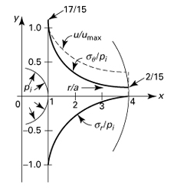



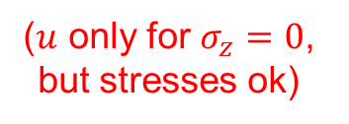
Special Case – Internal Pressure Only
Max radial stress on inner surface (compressive)
Max circumferential stress on inner surface (tensile)
($u$ only for $σ_{z}=0$, but stresses ok)

Slide 14
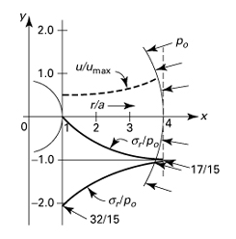




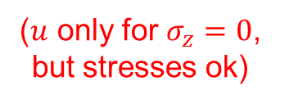
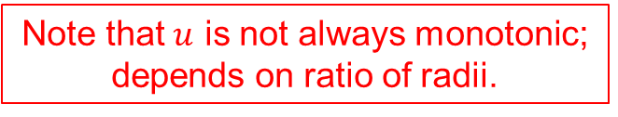
Special Case – External Pressure Only
Note that $u$ is not always monotonic; depends on ratio of radii.
Max radial stress on outer surface (compressive)
Max circumferential stress on inner surface (compressive)
($u$ only for $σ_{z}=0$, but stresses ok)

Slide 15
Thick-Walled Pressure Vessels
Note that max tangential (circumferential) stress acts at inner surface in both cases … not always true if pressure acts on both surfaces (see next slide)
Where does maximum shear stress occur?

Slide 16
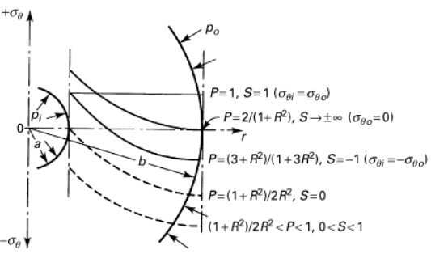

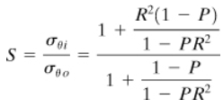
Thick-Walled Pressure Vessels
Let $R=b/a$, $P=p_{o}/p_{i}$, and $S=σ_{θi}/σ_{θo}$.
Then,
Largest circumferential stress is on outside surface for dashed cases, but behavior is still monotonic through the wall (max on either inside or outside).

Slide 17
Stress with Various Combinations
Consider internal only; external only; combined

Slide 18
Disp, Strain with Various Combinations
Consider internal only; external only; combined

Slide 19
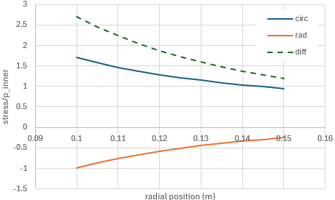
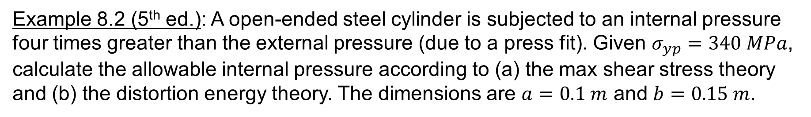
Thick-Walled Pressure Vessels
Example 8.2 (5th ed.): A open-ended steel cylinder is subjected to an internal pressure four times greater than the external pressure (due to a press fit). Given $σ_{yp}=340 MPa$, calculate the allowable internal pressure according to (a) the max shear stress theory and (b) the distortion energy theory. The dimensions are $a=0.1 m$ and $b=0.15 m$.

Slide 21
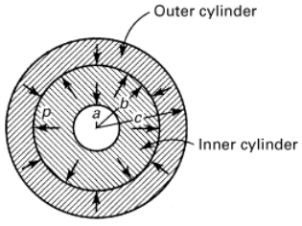
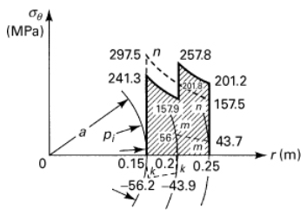
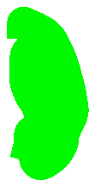
Compound Cylinders: Press or Shrink Fits
Compound cylinder can improve performance by inducing pre-stresses that lower operational stresses and use material more efficiently
Lower right: press-fit creates compressive and tensile pre-stresses in inner and outer cylinders, respectively; results in (somewhat) lower stresses during operation
operating stresses w-o press-fit
pre-stresses

Slide 22




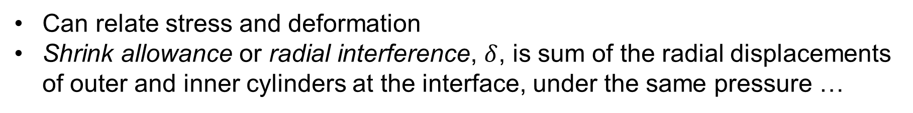
Compound Cylinders: Press or Shrink Fits
Can relate stress and deformation
Shrink allowance or radial interference, $δ$, is sum of the radial displacements of outer and inner cylinders at the interface, under the same pressure …
+
inside
outside
If materials are the same,

Slide 23






Rotating Disks – Constant Thickness
Still axisymmetric, so equilibrium equations look very similar … but we now need to account for radial acceleration
Differential equation becomes …
Requires homogeneous and particular solutions. Solving and utilizing definitions for strain and relationships with stress …

Slide 24
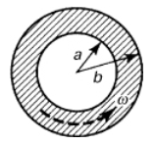
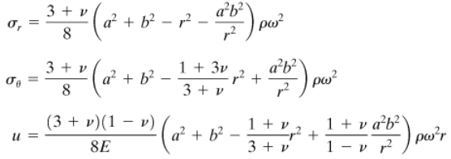
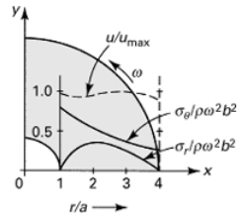

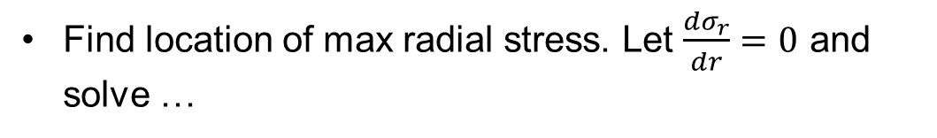

Annular Disk
Boundary conditions:
Then,
Find location of max radial stress. Let $\frac{{dσ}_{r}}{dr}=0$ and solve …
(occurs at $r=\sqrt{ab}$)

Slide 25
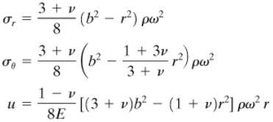
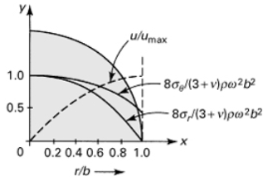
Solid Disk
Boundary conditions:
Then,
* If small hole in center of solid disk, circ stress doubles!

Slide 26

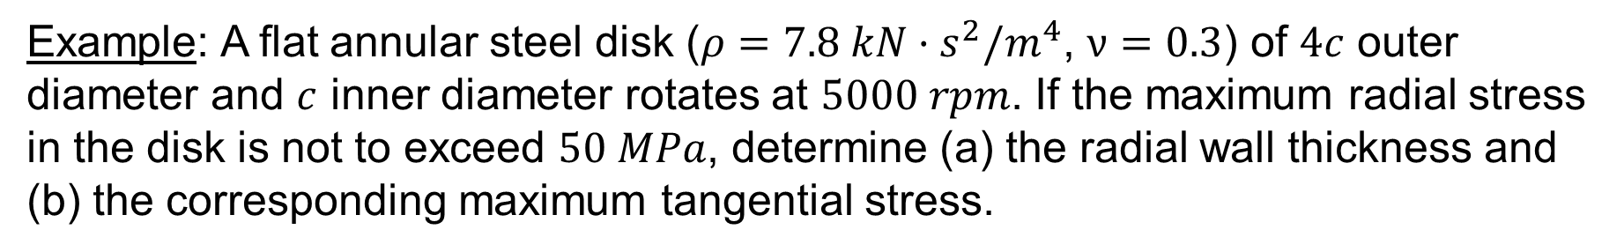
Rotating Disks – Constant Thickness
Example: A flat annular steel disk ($ρ=7.8 kN·s^{2}/m^{4}$, $ν=0.3$) of $4c$ outer diameter and $c$ inner diameter rotates at $5000 rpm$. If the maximum radial stress in the disk is not to exceed $50 MPa$, determine (a) the radial wall thickness and (b) the corresponding maximum tangential stress.

Slide 27


Slide 28
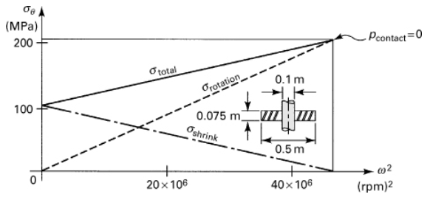
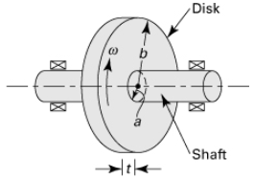
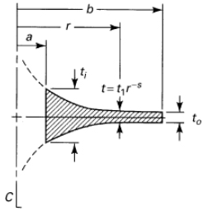
Rotating Disks
Flywheels: superposition between press fit (thick-walled pressure vessel equations) and inertial loading
(circumferential stress - flywheel)
(radial stress)
Constant thickness disks do not make optimum use of material, so different shapes are often used

